Slide 1



Team Amazon Sprint 3
MEDIABazaar
March 1, 2021

Slide 2



Who is MEDIABazaar?
Solution to enhance stability and increase productivity in a chaotic multi-channeled sales order and fulfilment environment.
Facilitating "sale to mail" clarity, oversight , and performance overview through dashboards and reporting simplification for small to medium sized organizations.

Slide 3
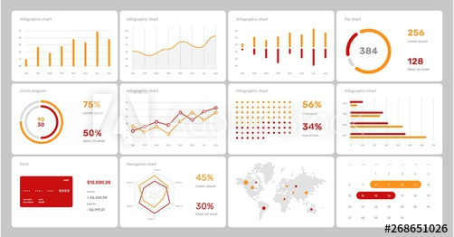
APIs pull data from top marketplaces
Automation of hold management
Personalized Reports & Data Mapping
Hundreds of Daily Pricing Updates
All in one manageable dashboard!

Slide 4
Meet MEDIABazaar
Team Member | Role | Current Project
Matthew Gerloff | Micro Applications | Brochure
Laxman Chamlagai | Front End Developer | Website
Rodney Layne | Project Manager / Developer | SQL
Tyler Wobschall | Developer | API
Regina Harless | Developer | MVC

Slide 5
To The Brochure:

